Slide 1
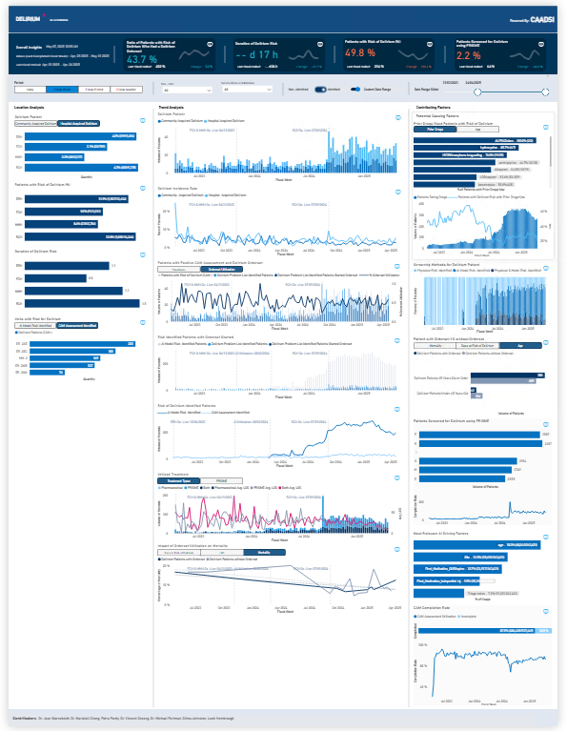
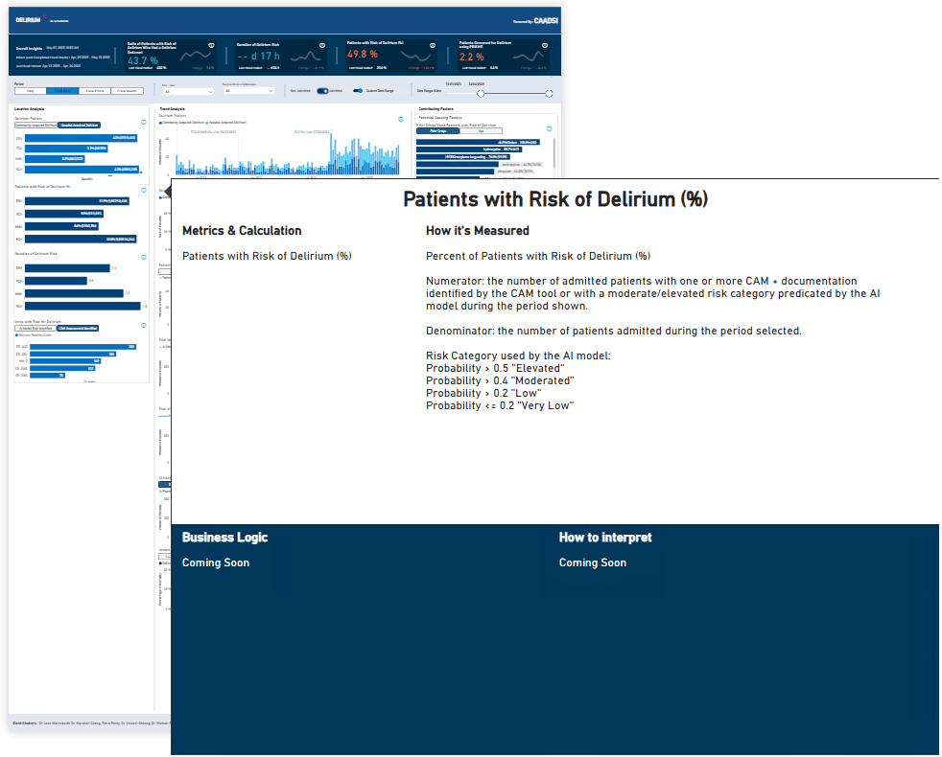
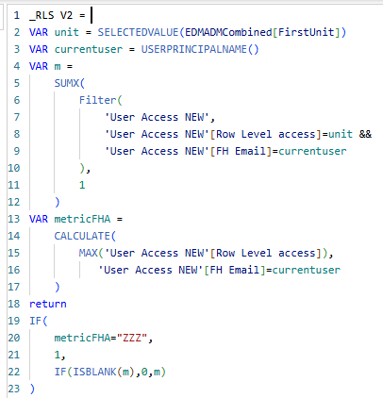
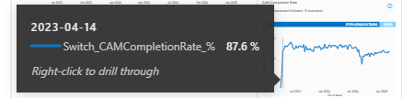
Title, Disclaimer, Definition Button
Highlight Cards ①
Period ②
Toggle ③ x 2
Bookmarks-linked Button ⑤
Definition-Interpretation Tooltip ④
Customized Data Label Value ⑥
Role-Level-Security (RLS) ⑧
Drill Through ⑦

